Slide 1
Experiential Learning Phase -II:
Course Code : CS235AI
Title
Implementing CPU Scheduling Algorithm.
Sudhanshu suman.
1RV22CS206.
Shreeram Shivabasu Badagandi.
1RV22CS188.
Shivakumar.
1RV22CS184.

Slide 2
PRESENTATION CONTENTS
Problem statement.
First Come First Serve.
Shortest Job First.
Round Robin Scheduling.
Priority Scheduling.
Importance of CPU Scheduling.
References.

Slide 3
PROBLEM STATEMENT
Implementing CPU scheduling algorithms :
First Come First Serve.
Shortest Job First(Preemptive and Non-Preemptive).
Round Robin Algorithm.
Priority Scheduling(Preemptive and Non - Preemptive).

Slide 4
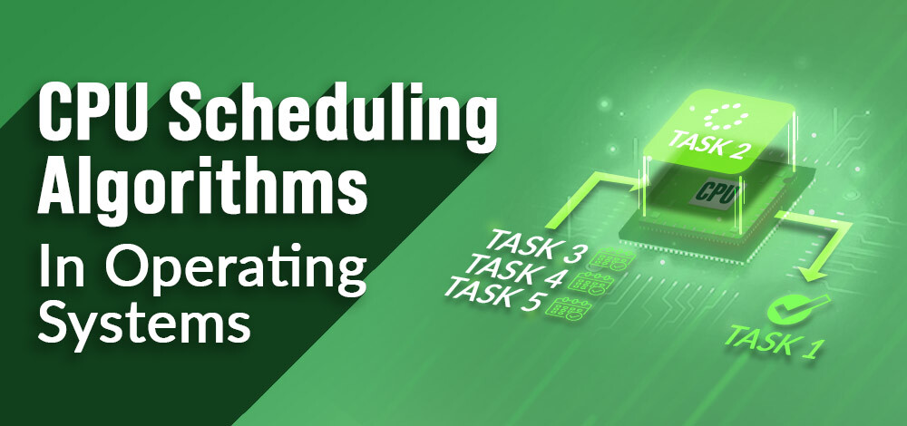
PROBLEM STATEMENT
Implementing CPU scheduling algorithms :
First Come First Serve.
Shortest Job First(Preemptive and Non-Preemptive).
Round Robin Algorithm.
Priority Scheduling(Preemptive and Non - Preemptive).

Slide 5
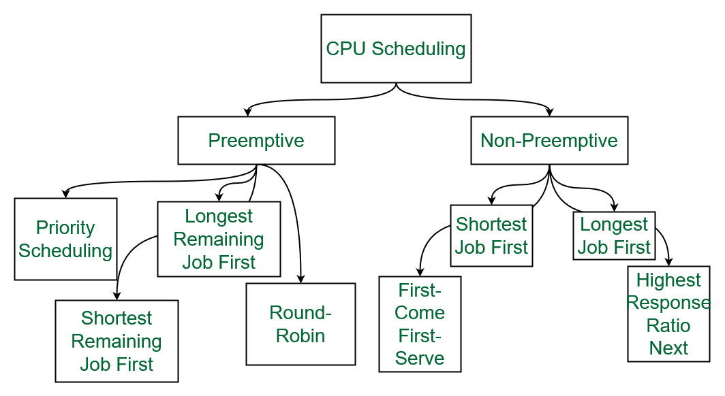
CPU SCHEDULING.

Slide 6
First Come First Serve CPU Scheduling.
Simplest CPU scheduling algorithm that schedules according to arrival times of processes.
The first come first serve scheduling algorithm states that the process that requests the CPU first is allocated the CPU first. It is implemented by using the FIFO queue.
When a process enters the ready queue, its PCB is linked to the tail of the queue. When the CPU is free, it is allocated to the process at the head of the queue.
The running process is then removed from the queue. FCFS is a non-preemptive scheduling algorithm.

Slide 7
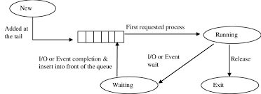
First Come First Serve CPU Scheduling.
Characteristics :
FCFS supports non-preemptive and preemptive CPU scheduling algorithms.
Tasks are always executed on a First-come, First-serve concept.
FCFS is easy to implement and use.
This algorithm is not very efficient in performance, and the wait time is quite high.
Flow Chart :

Slide 8
Shortest Job First CPU Scheduling (Preemptive).
In the Shortest Remaining Job First (SRJF) scheduling algorithm, the process with the smallest amount of time remaining until completion is selected to execute.
Since the currently executing process is the one with the shortest amount of time remaining by definition, and since that time should only reduce as execution progresses, processes will always run until they complete or a new process is added that requires a smaller amount of time.
Characteristics :
Short processes are handled very quickly.
The system also requires very little overhead since it only makes a decision when a process completes or a new process is added.
When a new process is added the algorithm only needs to compare the currently executing process with the new process, ignoring all other processes currently waiting to execute.

Slide 9
Shortest Job First CPU Scheduling.
(Non-Preemptive).
The shortest job first (SJF) or shortest job next, is a scheduling policy that selects the waiting process with the smallest execution time to execute next. SJN, also known as Shortest Job Next (SJN).
Characteristics :
Shortest Job first has the advantage of having a minimum average waiting time among all scheduling algorithms.
It is a Greedy Algorithm.
It may cause starvation if shorter processes keep coming. This problem can be solved using the concept of ageing. It is practically infeasible as Operating System may not know burst times and therefore may not sort them.
While it is not possible to predict execution time, several methods can be used to estimate the execution time for a job, such as a weighted average of previous execution times.

Slide 10
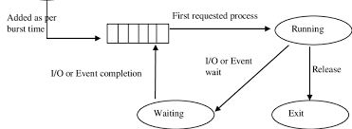
Shortest Job First CPU Scheduling.
(Non-Preemptive).
Flow Chart :

Slide 11
Round Robin Scheduling Algorithm.
Round Robin is a CPU scheduling algorithm where each process is cyclically assigned a fixed time slot. It is the preemptive version of the First come First Serve CPU Scheduling algorithm.
Round Robin CPU Algorithm generally focuses on Time Sharing technique.
The period of time for which a process or job is allowed to run in a pre-emptive method is called time quantum.
Each process or job present in the ready queue is assigned the CPU for that time quantum, if the execution of the process is completed during that time then the process will end else the process will go back to the waiting table and wait for its next turn to complete the execution.
Characteristics :
It is simple, easy to implement, and starvation-free as all processes get a fair share of CPU.

Slide 12
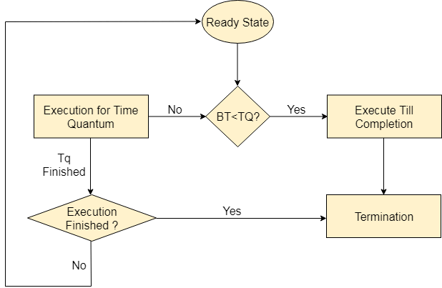
Round Robin Scheduling Algorithm.
One of the most commonly used techniques in CPU scheduling is a core.
It is preemptive as processes are assigned CPU only for a fixed slice of time at most.
The disadvantage of it is more overhead of context switching.
Flow Chart :

Slide 13
Priority CPU Scheduling Algorithm.
Priority scheduling is one of the most common scheduling algorithms in batch systems. Each process is assigned a priority.
The process with the highest priority is to be executed first and so on.
Processes with the same priority are executed on a first-come first served basis. Priority can be decided based on memory requirements, time requirements or any other resource requirement.
Also priority can be decided on the ratio of average I/O to average CPU burst time.
Advantages:
Priority-based scheduling ensures that high-priority processes are executed first, which can lead to faster completion of critical tasks.
Priority scheduling is useful for real-time systems that require processes to meet strict timing constraints.

Slide 14
Priority CPU Scheduling Algorithm.
Priority scheduling can reduce the average waiting time for processes that require a significant amount of CPU time.
Disadvantages:
Priority inversion: Priority inversion occurs when a low-priority process holds a resource that a high-priority process requires. This can cause delays in the execution of high-priority processes.
Starvation: If the system is heavily loaded with high-priority processes, low-priority processes may never get a chance to execute.
Priority inversion avoidance techniques, such as priority inheritance or priority ceiling protocols, can introduce additional complexity to the system.
Setting priorities can be a difficult task, especially when there are many processes with different priorities.

Slide 15
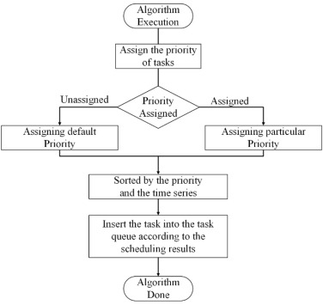
Priority CPU Scheduling Algorithm.

Slide 16
Importance Of CPU Scheduling.
Resource Utilization: Effective CPU scheduling ensures that the CPU is utilized efficiently. By keeping the CPU busy with processes, the system can maximize throughput and minimize idle time.
Fairness: CPU scheduling ensures fairness among processes. It allocates CPU time fairly among competing processes, preventing any single process from monopolizing the CPU and starving others.
Response Time: Good scheduling algorithms aim to minimize the response time for interactive processes. This improves the overall user experience by ensuring quick responses to user inputs.
Turnaround Time: CPU scheduling affects the turnaround time, which is the total time taken to execute a process from submission to completion. Minimizing turnaround time is important for enhancing system performance and user satisfaction.

Slide 17
Importance Of CPU Scheduling.
Throughput: Throughput refers to the number of processes completed per unit of time. Efficient CPU scheduling can increase throughput by optimizing the execution of processes, leading to better system performance.
Priority Management: Some processes may have higher priority than others, based on factors such as system requirements or user preferences. CPU scheduling allows for the management of process priorities, ensuring that critical tasks are executed in a timely manner.
Resource Allocation: CPU scheduling is essential for allocating system resources effectively. It determines which processes get access to the CPU and for how long, as well as managing other resources such as memory and I/O devices.

Slide 18
Importance Of CPU Scheduling.
Adaptability: Different scheduling algorithms are suited to different types of systems and workloads. CPU scheduling allows for the selection and implementation of appropriate algorithms based on the specific requirements and characteristics of the system. Overhead
Reduction: Efficient CPU scheduling can help reduce overhead associated with context switching and process management. By minimizing unnecessary overhead, system performance can be improved.
Predictability: Predictable behavior is crucial for real-time systems and applications. CPU scheduling plays a role in ensuring predictable performance by maintaining consistent response times and meeting deadlines for time-sensitive tasks.

Slide 19
REFERENCES
Simulation of Priority Round-Robin Scheduling Algorithm
Tri Dharma Putra, Rakhmat Purnomo Universitas Bhayangkara Jakarta Raya rakhmat.purnomo@dsn.ubharajaya.ac.id
Submitted : Aug 9, 2022 | Accepted : Aug 18, 2022 | Published : Oct 3, 2022
link : https://jurnal.polgan.ac.id/index.php/sinkron/article/download/11665/1135.
Performance analysis of FCFS and improved FCFS scheduling algorithms for dynamic real-time computer systems (IEEE).
An Improved SJF Scheduling Algorithm in Cloud Computing Environment By Mokhtar A. Alworafi,DoS in CS,Mysore University, India

